Slide 1
Requesting A Customernet User ID (SSO)
CustomerNet User Registration & Password Reset Instructions

Slide 2
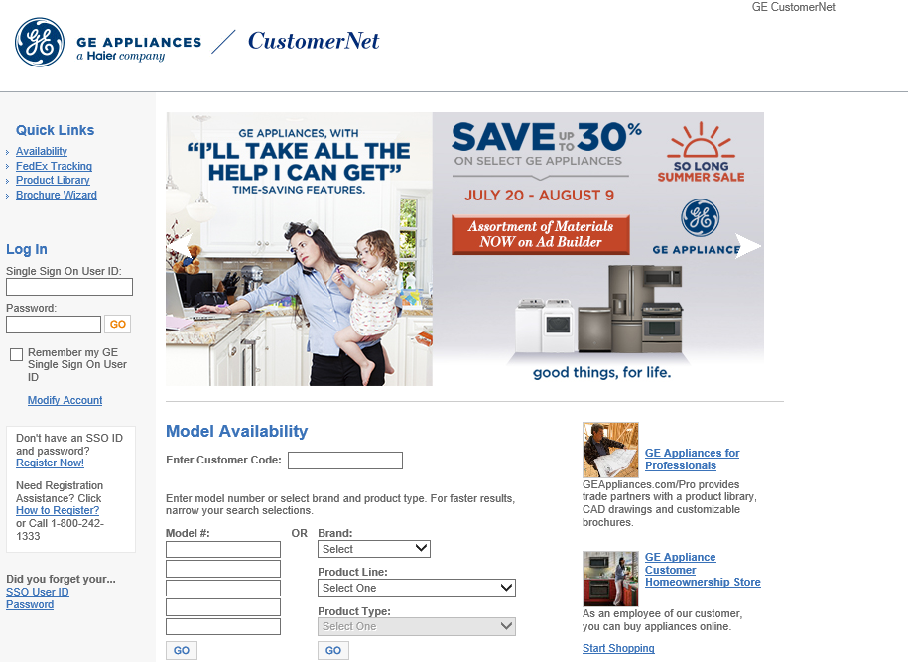
Link to customernet
Link: gecustomernet.com

Slide 3
New User Request

Slide 4
New User Request
Before using the CustomerNet Portal, all users must register for an SSO (Single Sign On) ID.
There is no limit to the amount of users who may register under an account.
To protect the security of your data, SSO IDs should be kept private and not shared among employees.

Slide 5
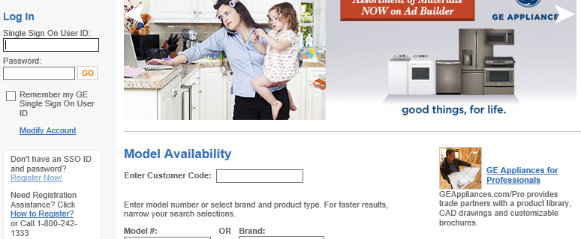
Request SSO
1. From the login page, click “Register Now”

Slide 6
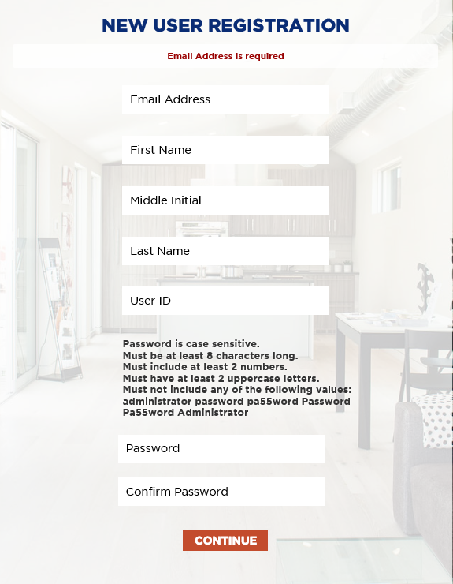
Registration Form
2. Complete the registration form
and click ‘Continue’

Slide 7
Registration form
You will receive an email with a verification code. You will copy the code and paste it into the box before selecting Check Code.

Slide 8
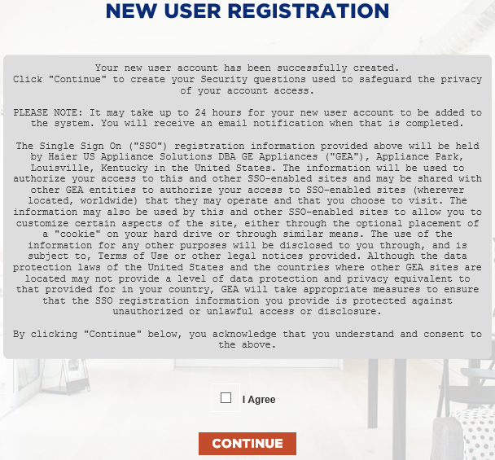
Terms and Conditions
3. Read the Terms and Conditions, check the box marked ‘I Agree’ and click ‘CONTINUE’

Slide 9
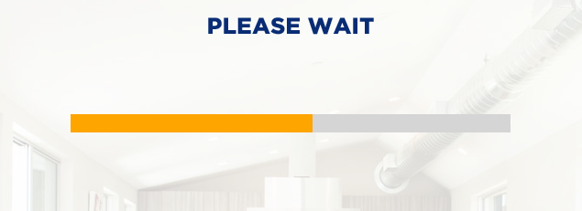
Account Creation
4. Wait for the account creation success message, and click ‘Continue’

Slide 10
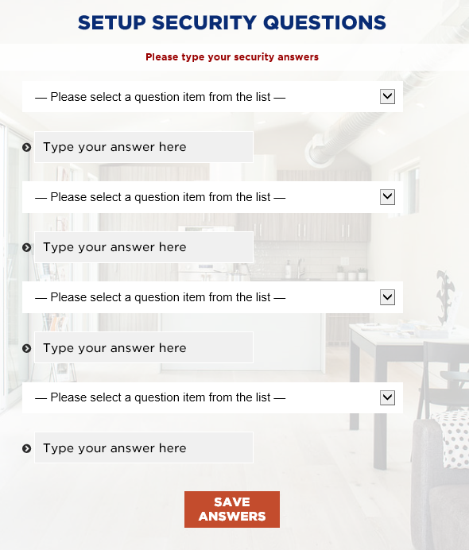
Security Questions
5. Select a security question and type an answer for each of the fields
Security answers cannot include part of the question and must be unique for each question
6. Click ‘Save Answers’ when complete
8. Click ‘Continue’. Your account has been created successfully.

Slide 11
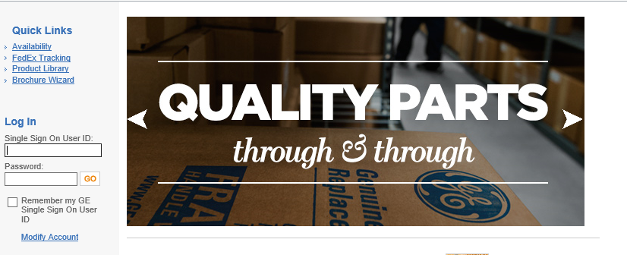
Login
You will be redirected back to the CustomerNet home page
Under ‘Log In’, enter your SSO and password. Click ‘Go’

Slide 12
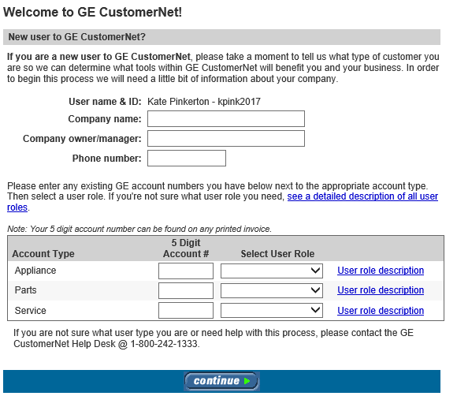
Requesting access
New user fills out:
Company name
Company manager
Phone number
Account # the user needs to view in CustomerNet
What user role they should be assigned
The user role defines the users level of authority with CustomerNet (click links to view descriptions of roles)

Slide 13
Approval
An email will be automatically be sent to the ASM for to approve the new user requests
Once approved, the new user is ready to log in!

Slide 14
Forgot Password

Slide 15
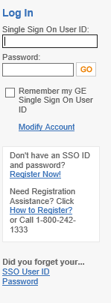
Forgotten Password
If you forget your password, please click the “Password” link under the Did you forget your… section.
Users registered before 8/6/17 must call the Help Desk to reset passwords

Slide 16
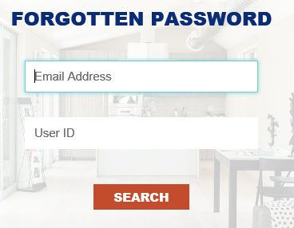
Forgotten Password
2. Enter your Email Address and User ID, then click ‘Search’

Slide 17
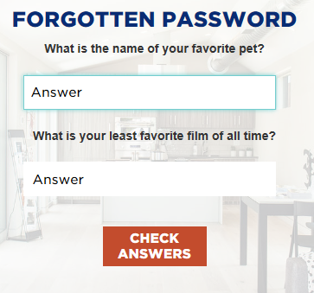
Forgotten Password
3. Enter the security question answers you created in the previous steps, and click ‘Check Answers’

Slide 18
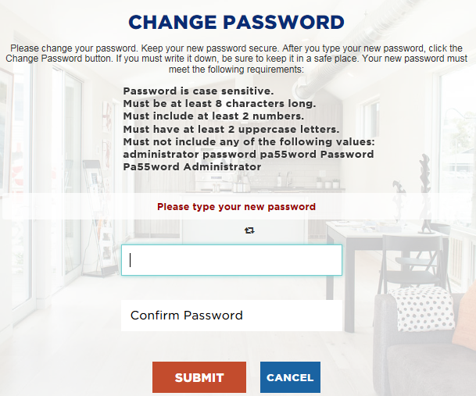
Forgotten Password
4. Enter your new password
and confirm
5. Click ‘Submit’

Slide 19
Forgotten Password
6. Once the password has been changed, click ‘Continue’ to log in

Slide 20
Who to contact for Help?
If you need further assistance, please contact the
GE CustomerNet Help Desk at:
Customernet@geappliances.com
1-800-242-1333
Monday – Friday, 8:00 AM – 6:00 PM Eastern Time

